Slide 1

Hospitals are Federally Mandated Killing Fields
Grace Schara’s death at the hands of medical personnel reminiscent of the Holocaust’s beginning

Slide 2





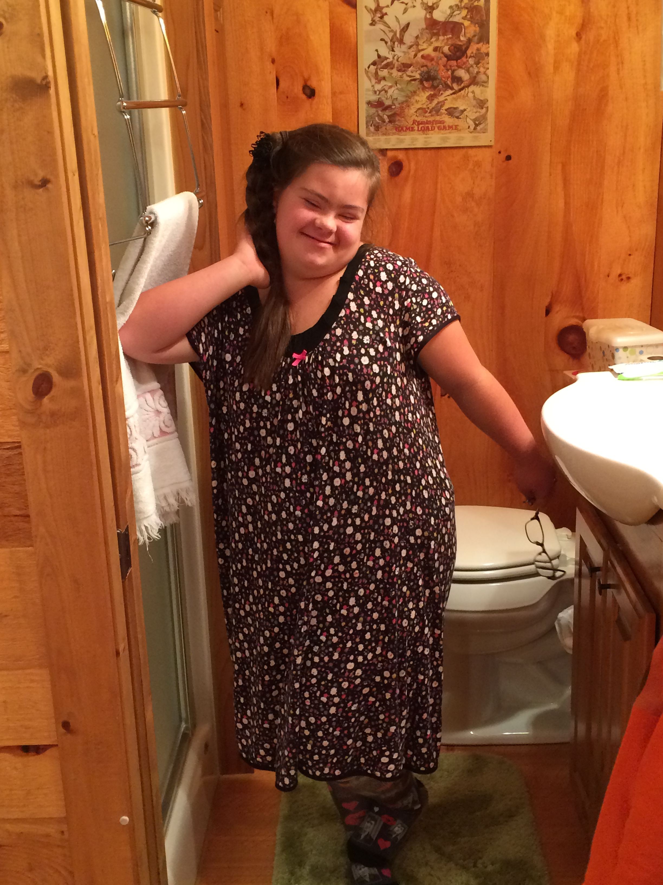

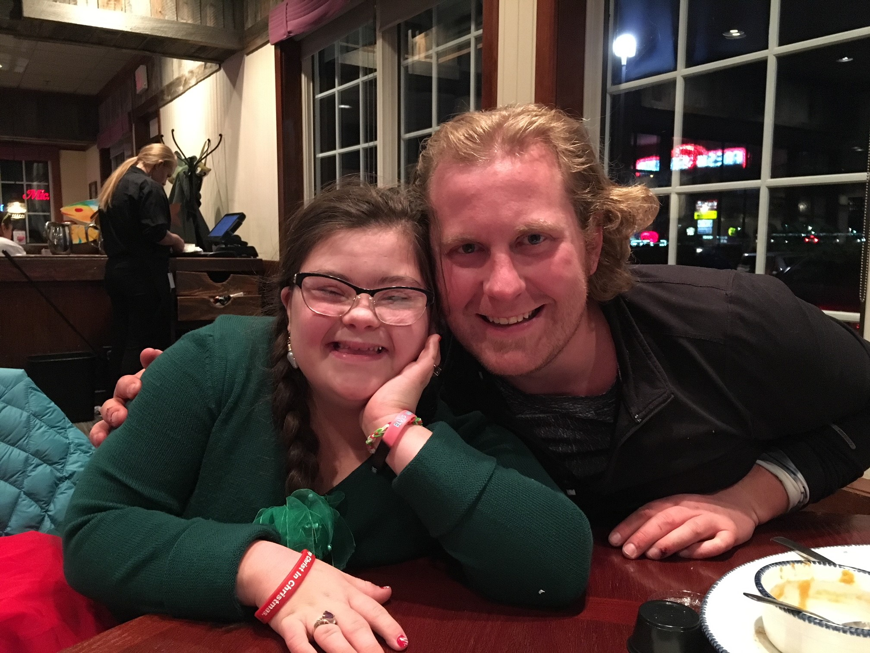

Who was Grace?

Slide 3
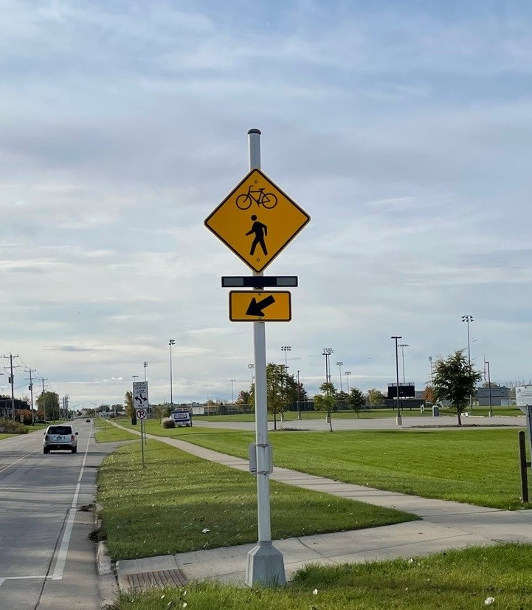

Grace had an amazing sense of humor.

Slide 4
What happened to Grace?

Slide 5
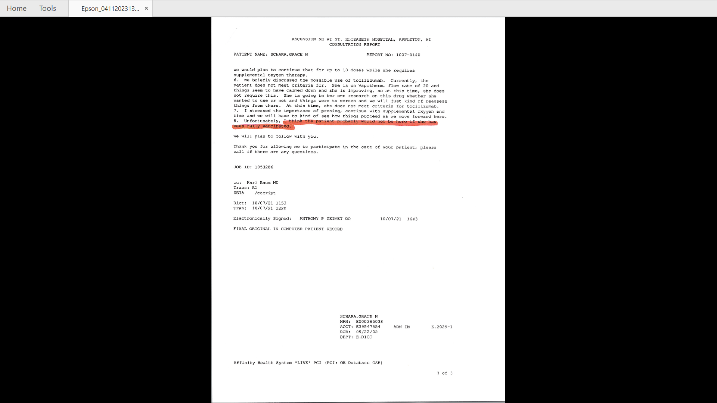

Slide 6
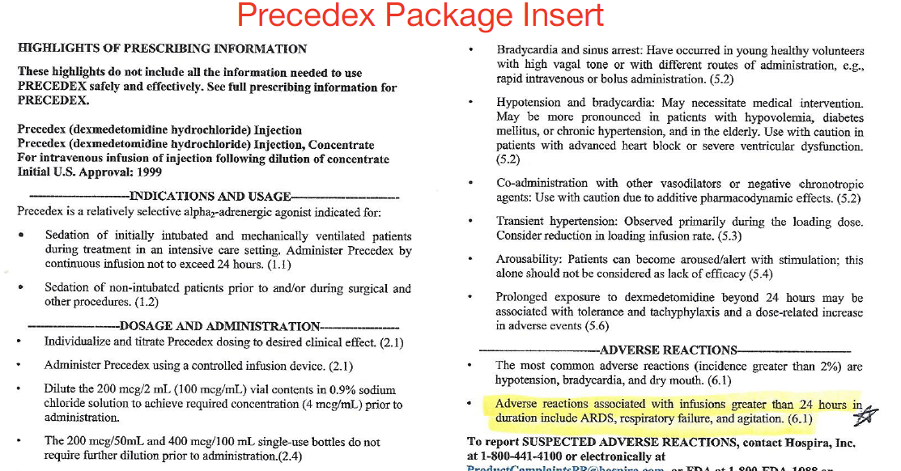

Slide 7
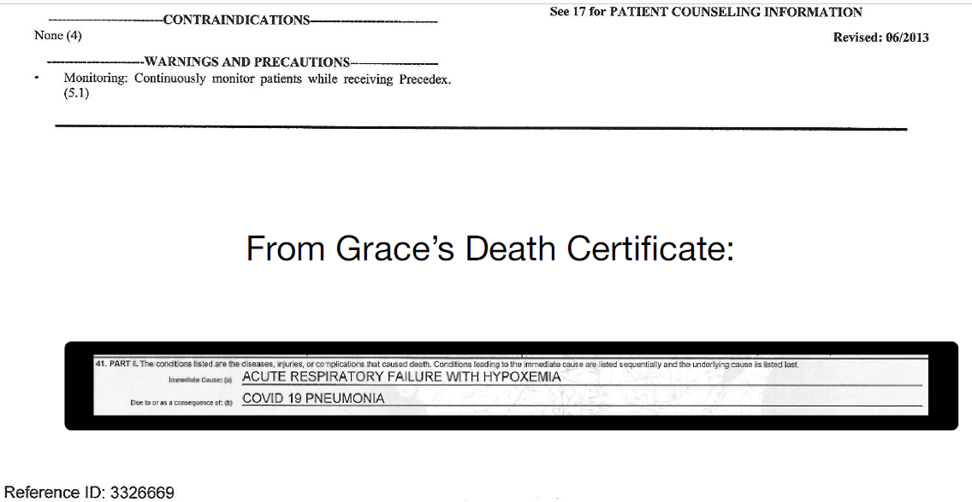

Slide 8
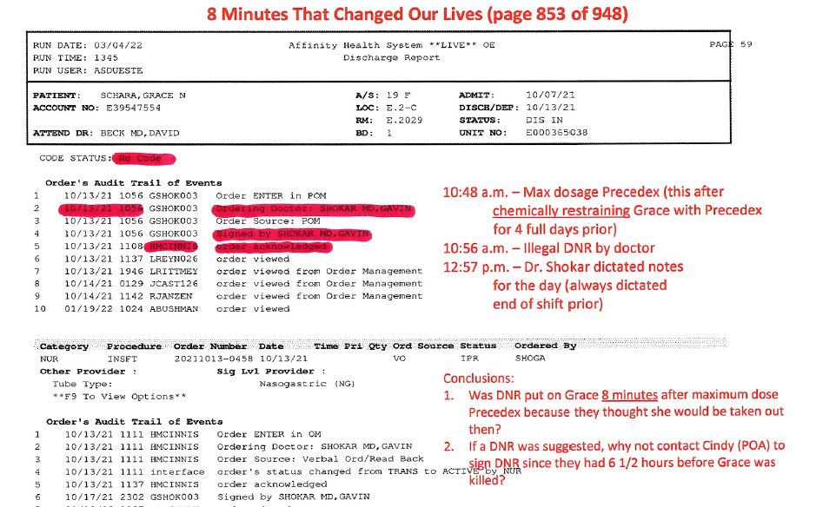

Slide 9
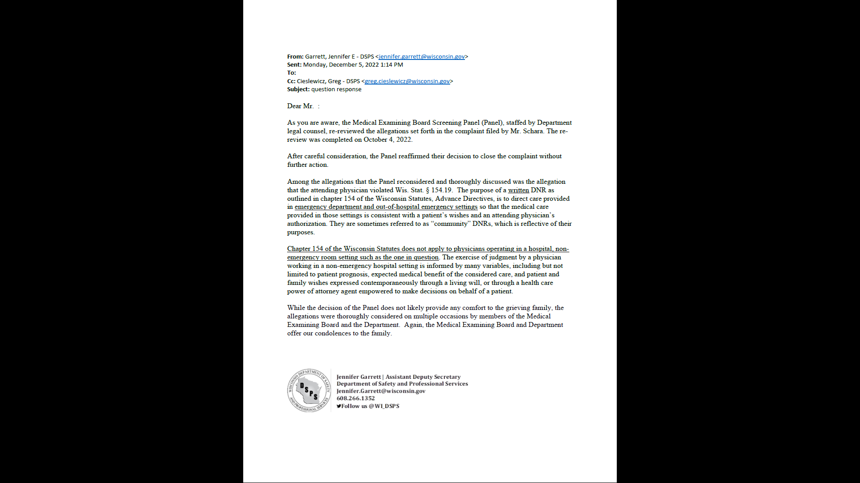

Slide 10
Why did this happen to Grace?

Slide 11
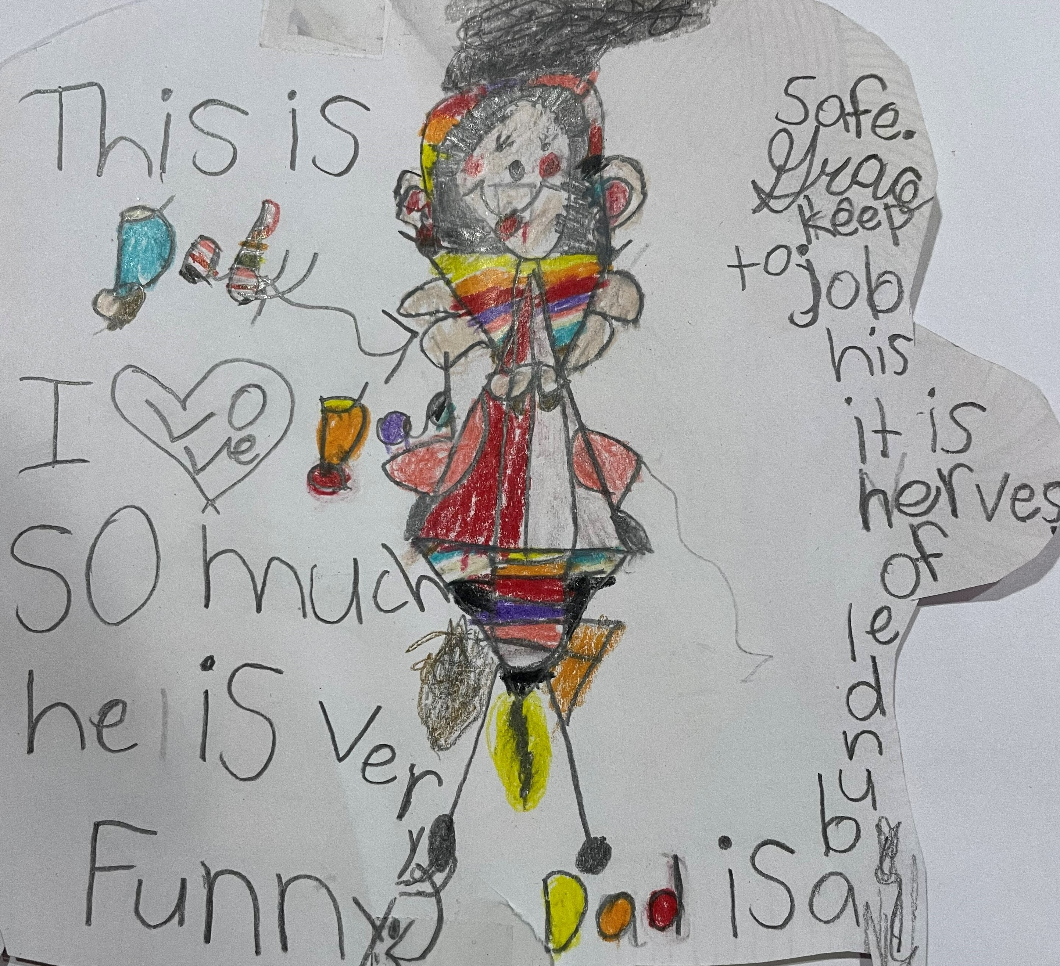

Slide 12
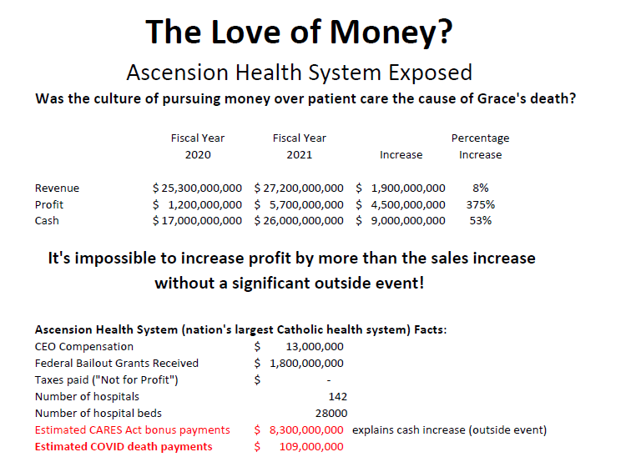

Slide 13

Steal from the poor and give to the rich!
From a nurse: “My mom was very vocal, a fighter, and I watched as they stole her voice and then killed her. I had always felt this was medical murder and the goal was never focused on getting her well. First, they rob you of all your assets and then murder you. At least this is what I have come to believe. And I really have come to believe there is an intent to rob one of all their money by recommending all kinds of expensive medical treatments and surgeries before murdering you.”

Slide 14
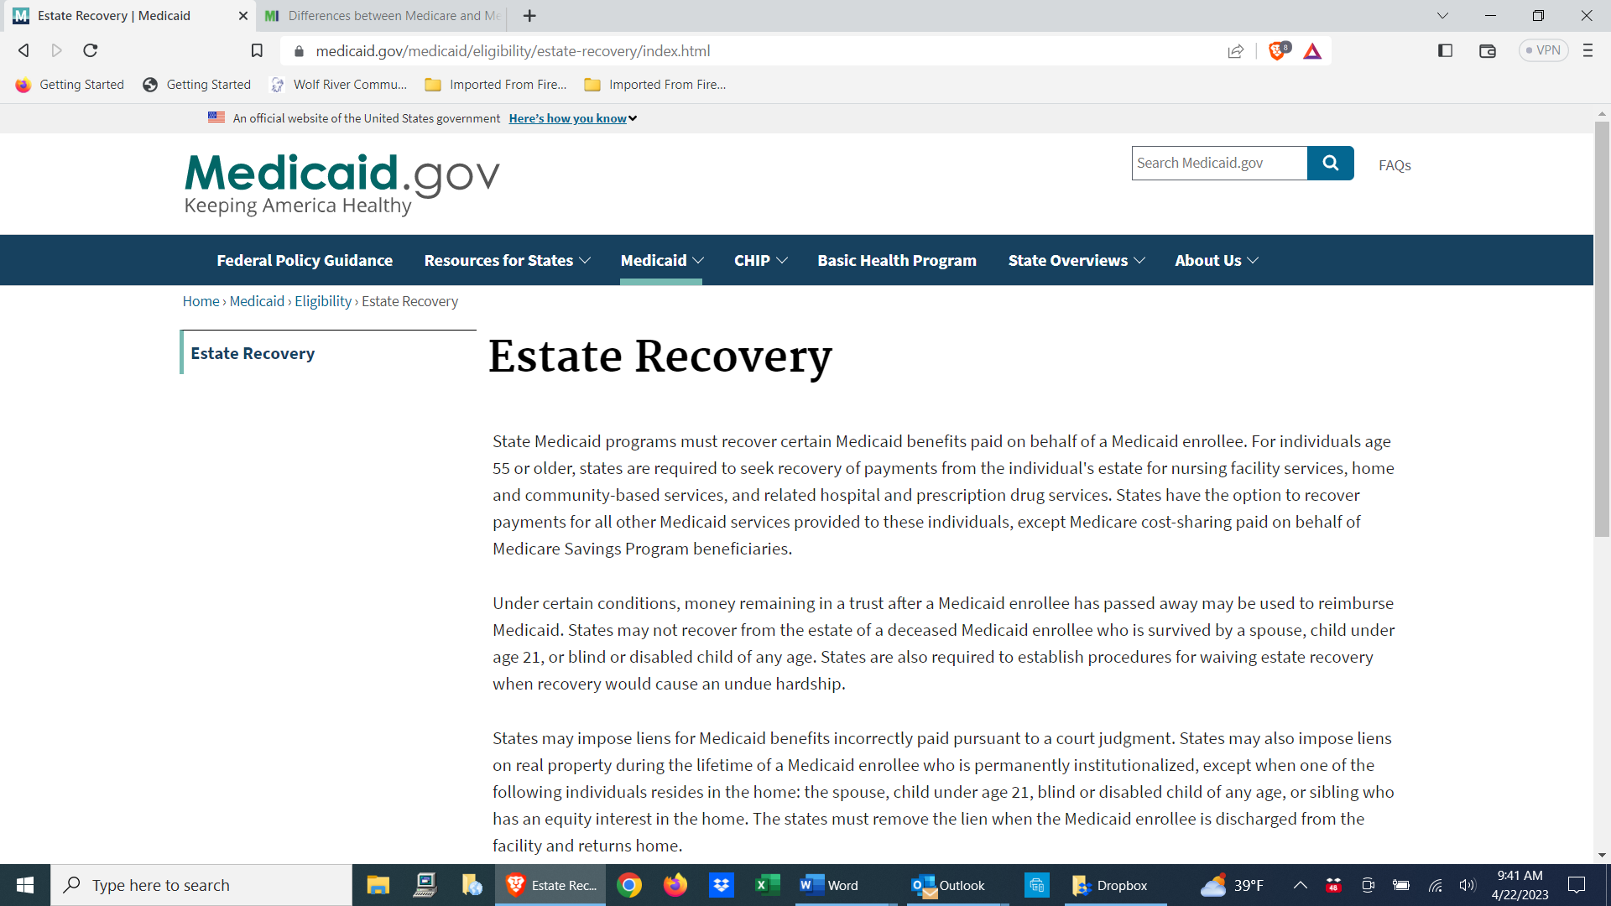

Slide 15
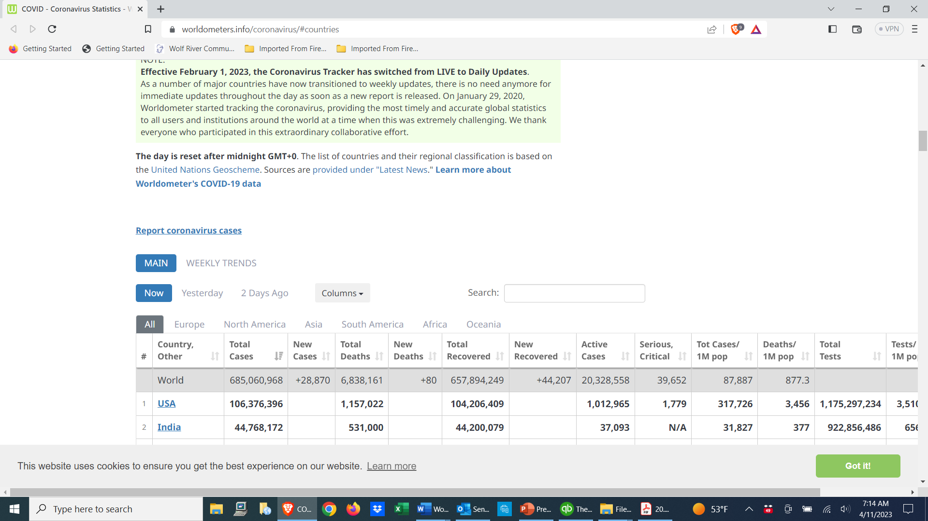

Slide 16
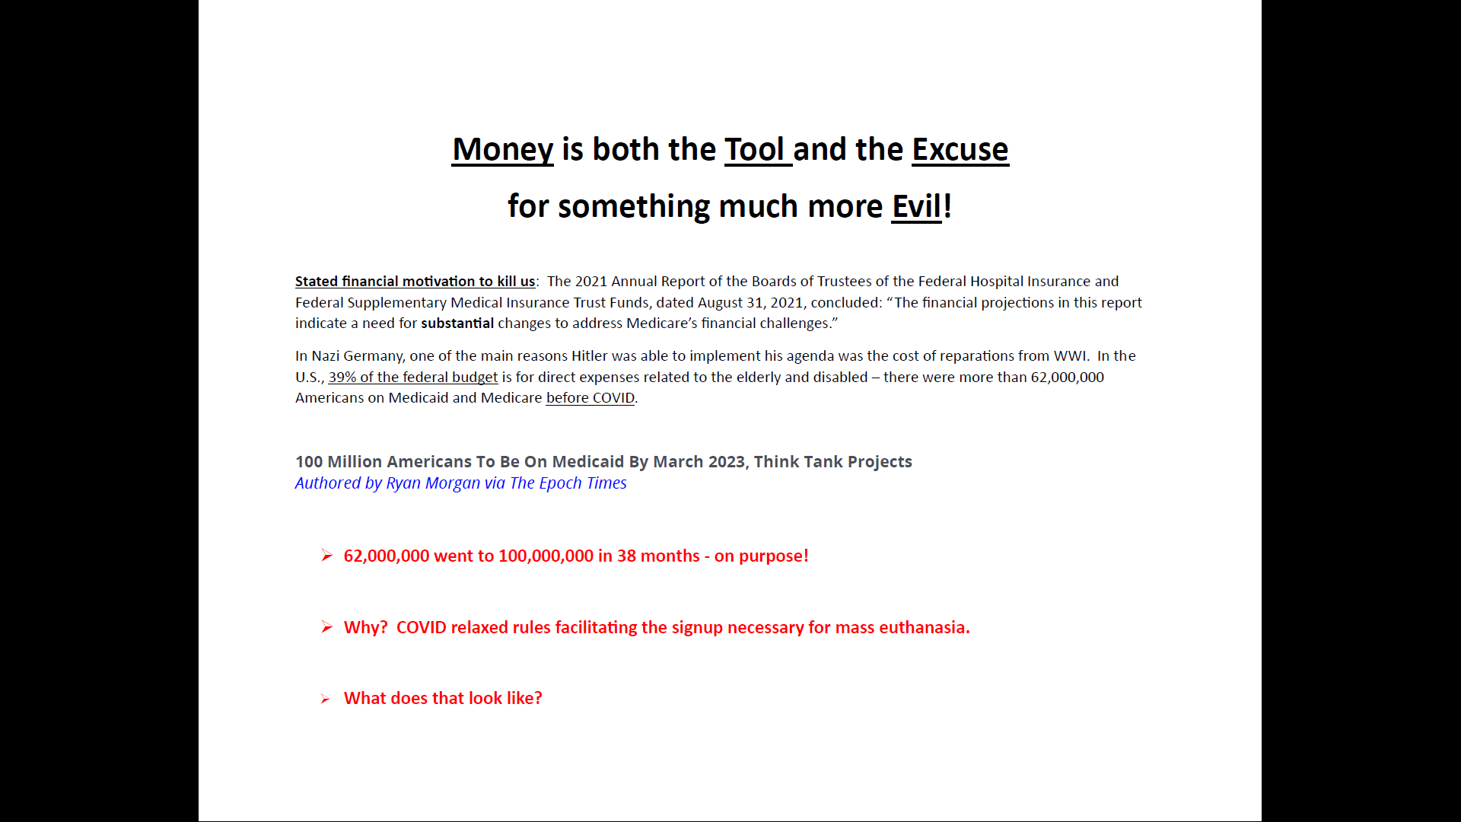

Slide 17
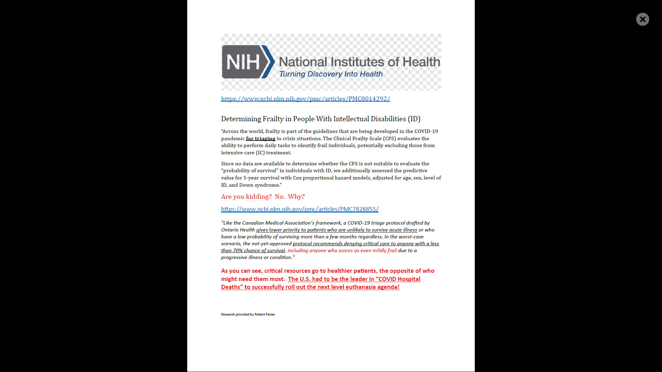

Slide 18
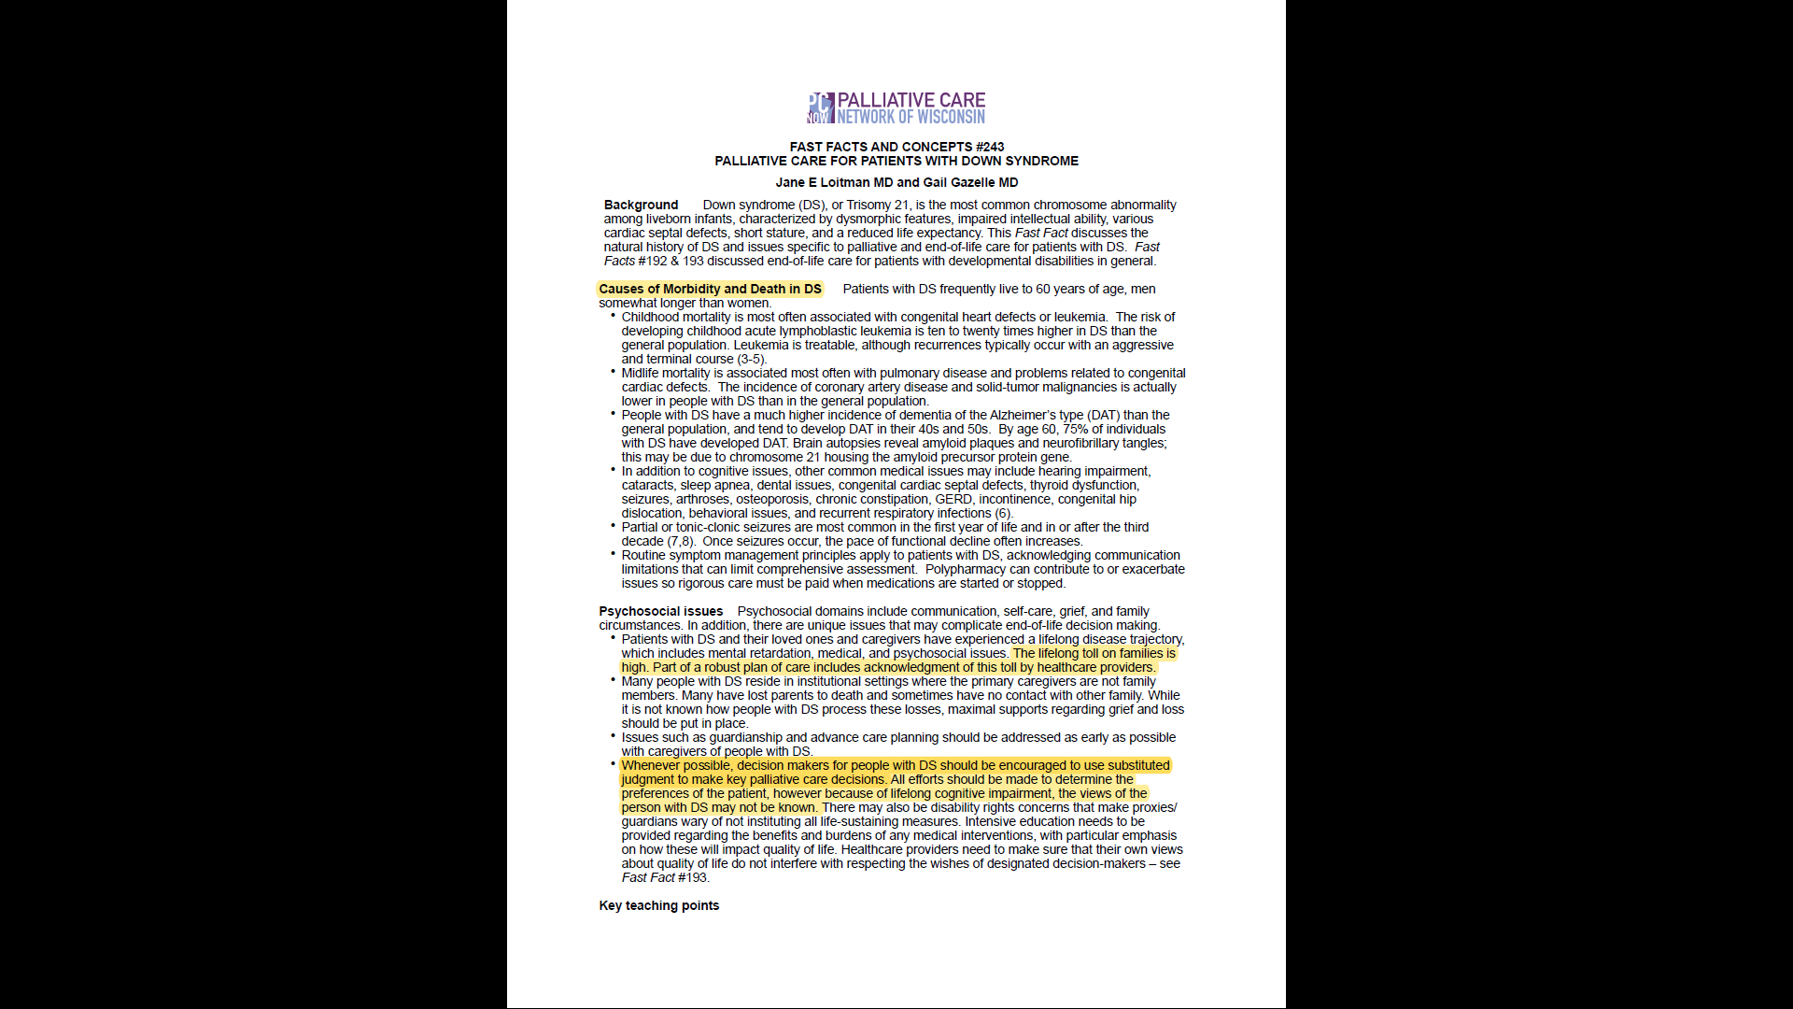

Slide 19
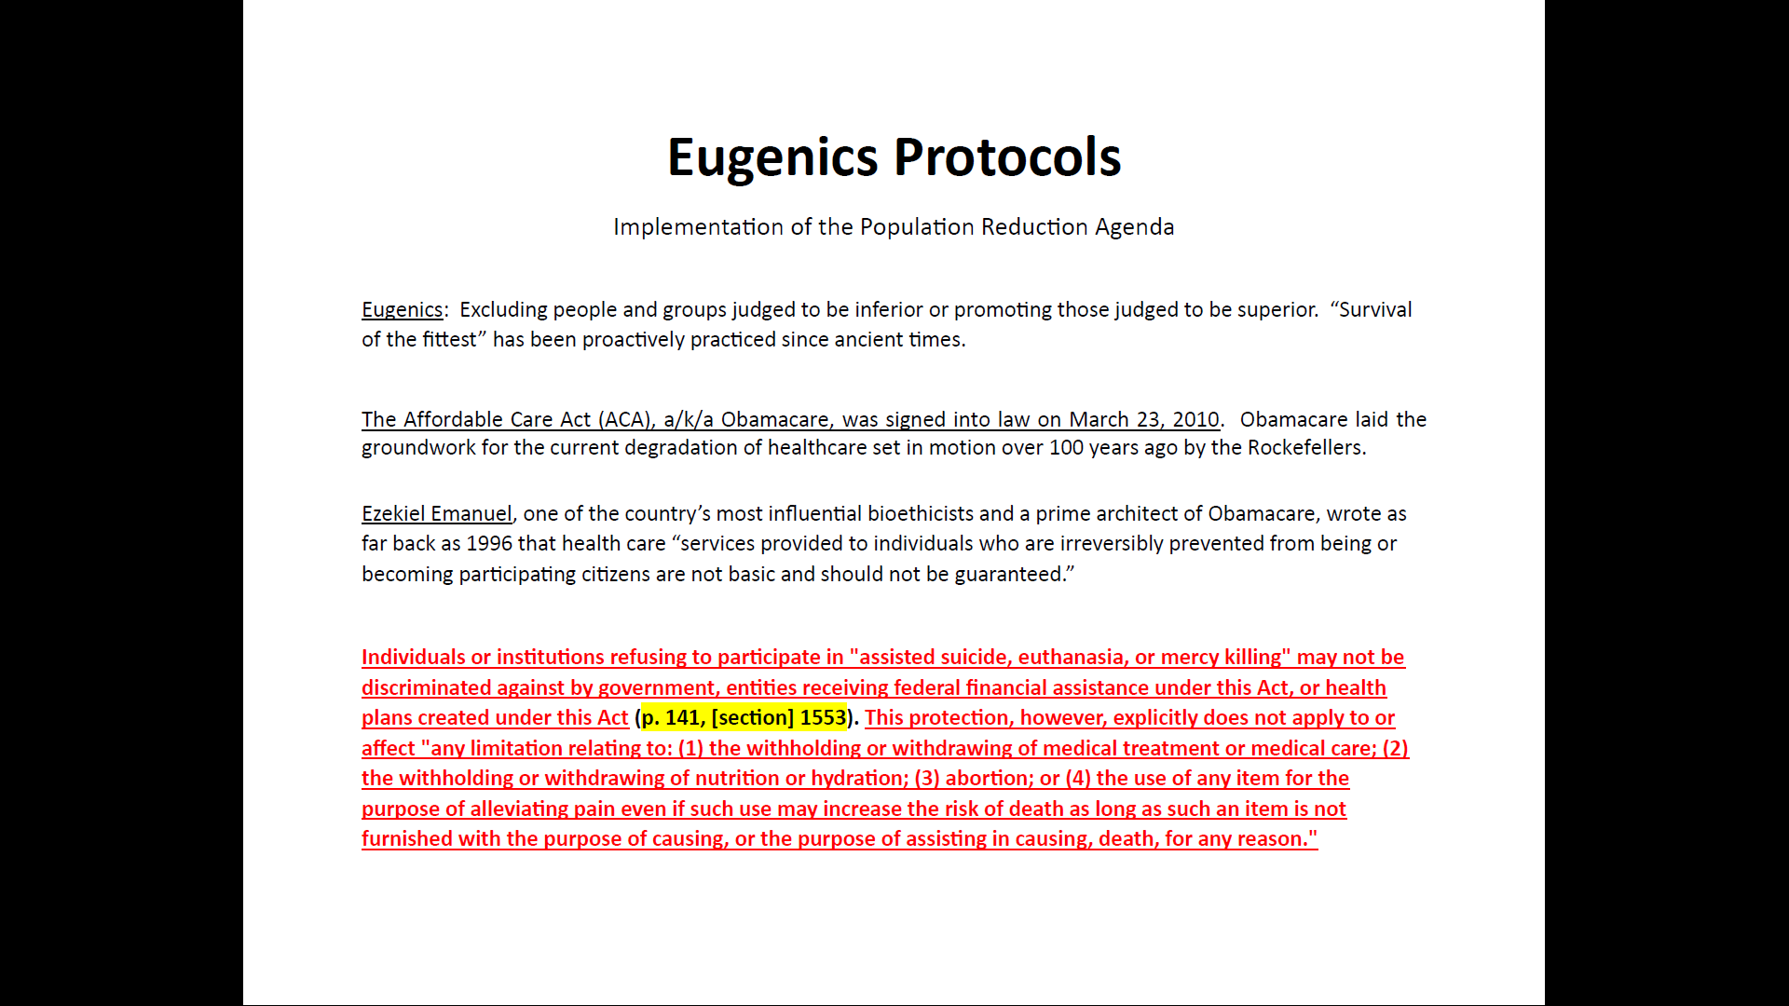

Slide 20
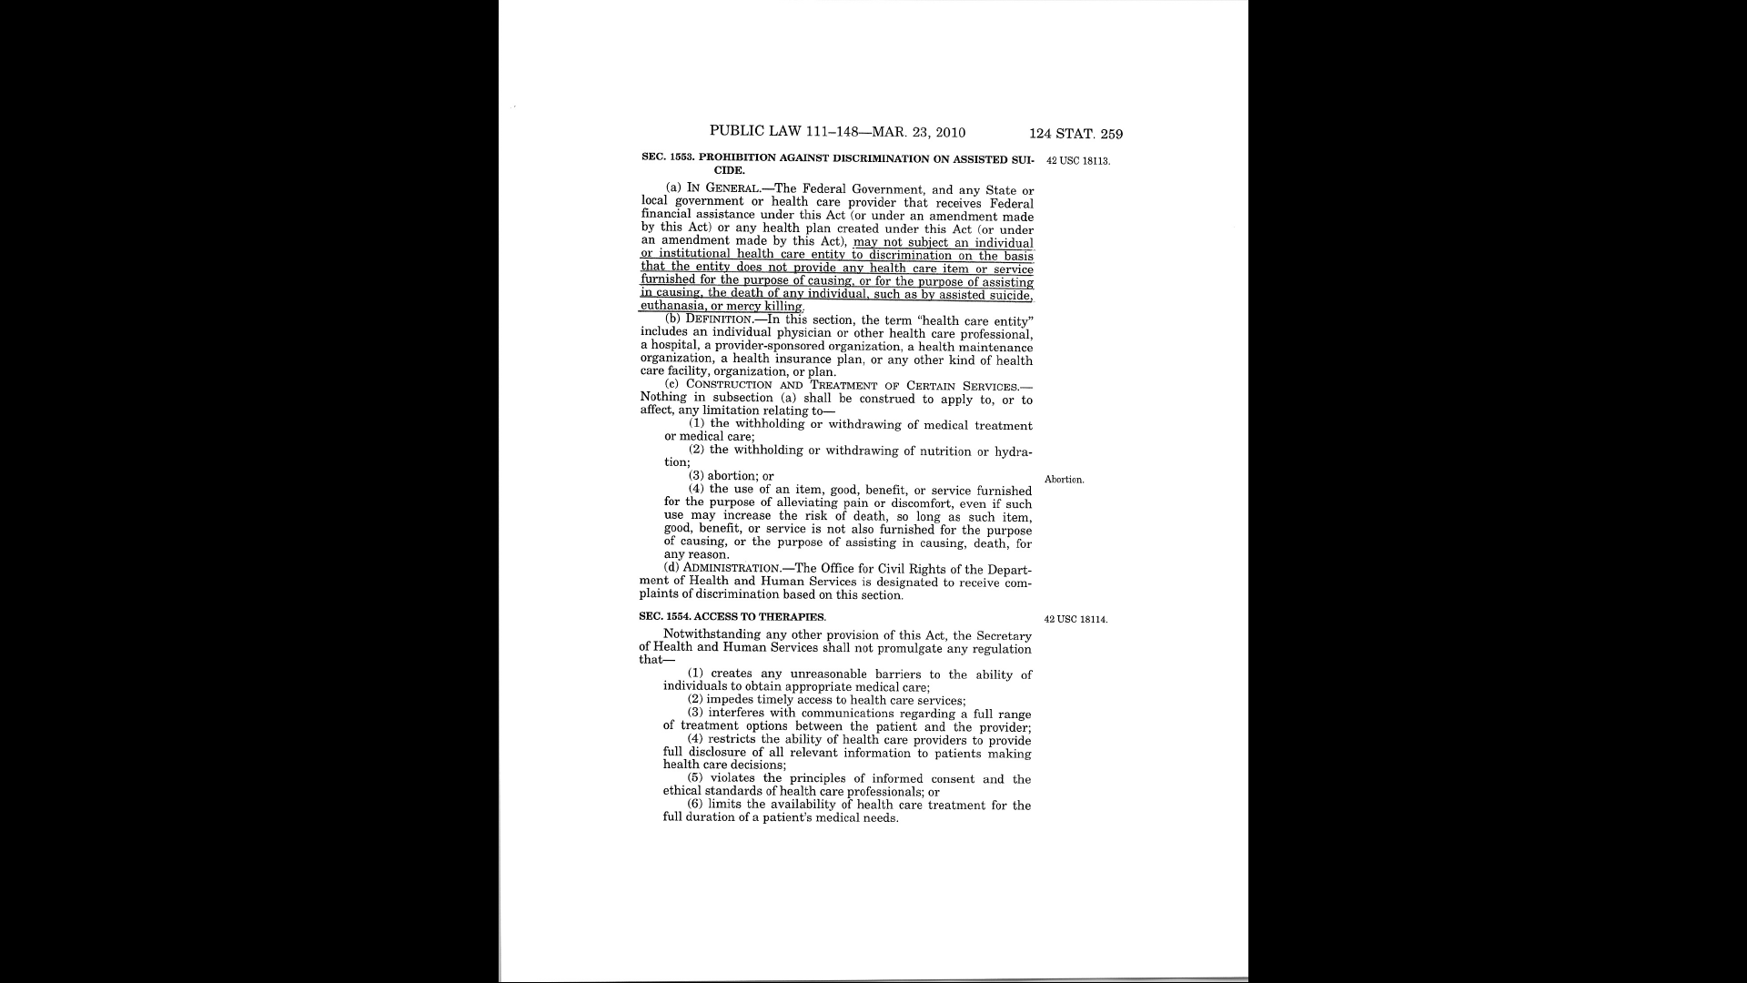

Slide 21
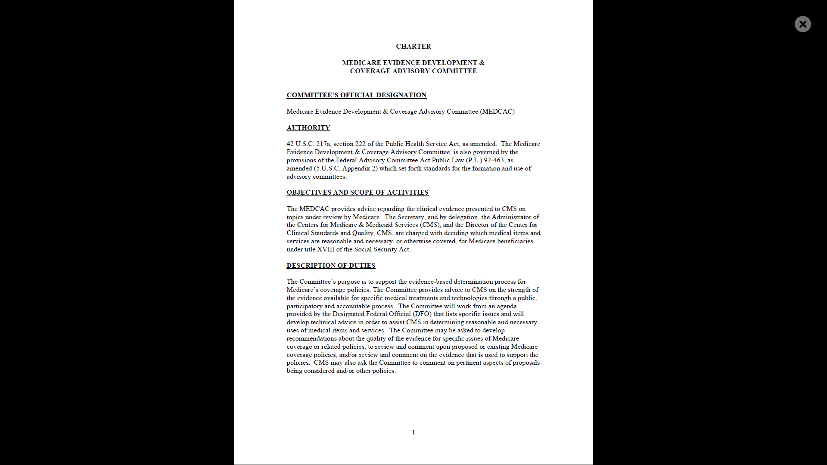

Slide 22
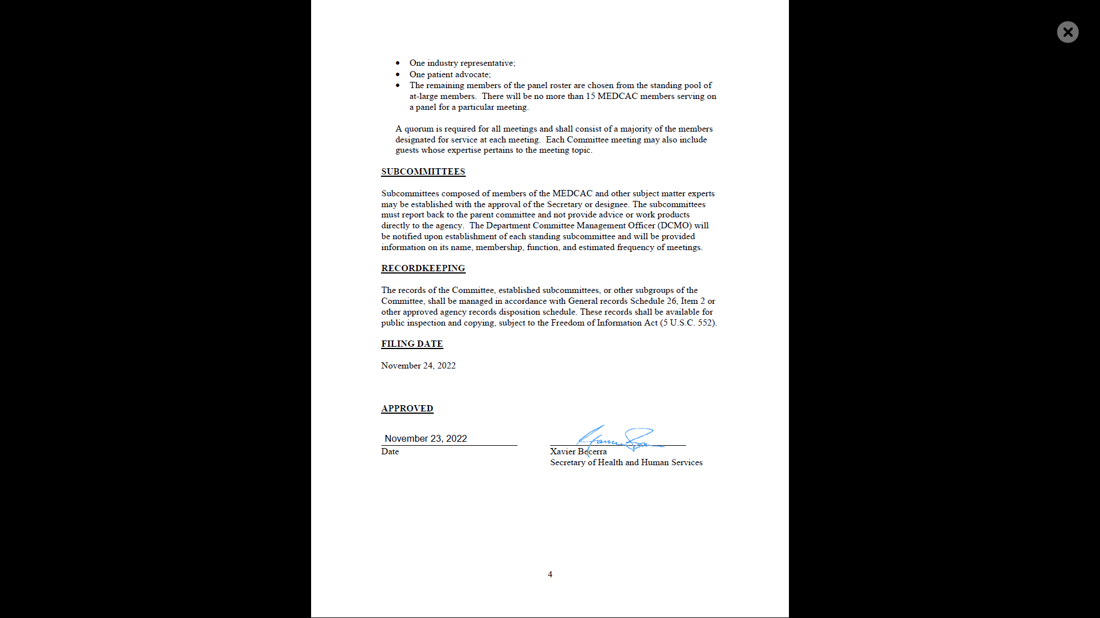

Slide 23

AMA Code of Medical Ethics 2.1.1 Informed Consent
Informed consent to medical treatment is fundamental in both ethics and law. Patients have the right to receive information and ask questions about recommended treatments so that they can make well considered decisions about care.

Slide 24
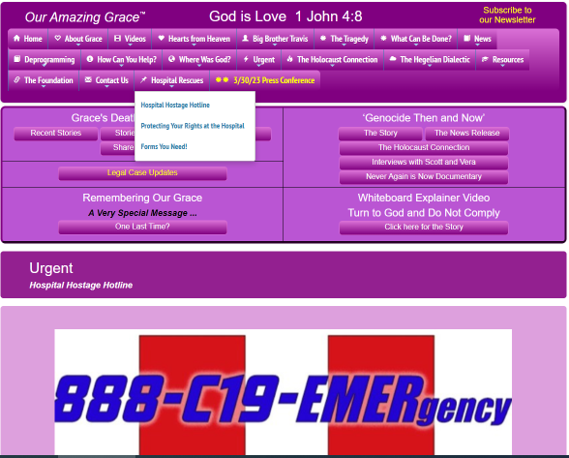

Slide 25

Follow Grace’s story…we’re not waiting for WWIII to end to take action!
Our family filed a landmark lawsuit on April 11, 2023 to shine a light on this evil agenda.
Grace did not die in vain…Genesis 50:20.

